Slide 1
Telecentres in the English speaking Caribbean: Relevance , Services and Sustainability Prepared for the workshop “Telecentres, bridges to Agricultural and Rural Development in the Caribbean, Santo Domingo, April 28-29, 2011
Valerie Gordon

Slide 2
WHAT?
A public place where people can access computers, the internet and other digital technologies that enable them to gather information, learn, and communicate with others to support community, economic, educational, and social development

Slide 3
Since When
Started appearing in the English speaking Caribbean in the late 1990’ s

Slide 4
WHY?
A mechanism to facilitate basic internet access to disadvantaged communities/ persons
Also seen as a mechanism to support communication, community development and individual development

Slide 5
Donor initiated programmes
UNDP - Sustainable Development Network - Jamaica, Guyana, Haiti (late 1990’s)
UNDP - CORICS – Community Resource and Internet Centers established in the OECS as part of UNDP Poverty Reduction Programme (2001-2005)
EU/Government of Belize – Belize Rural Development Programme – established as part of a broader rural development programme targeting poverty reduction (2008- 2009)

Slide 6
Government Programmes
Jamaica – Community Access Points established by the Ministry of Industry Commerce and Technology (2006-8) 14 established; Universal Access Fund established 42 centers over the last 12 months; plans additional centers
Trinidad and Tobago - Community Telecenters being established as part of the ICT component of Vision 2020. (14 planned, 6 established); only 3 in 2009
St Kitts and Nevis- Community telecenters;16 in St Kitts, 6 in Nevis

Slide 7
Studies of Caribbean Telecenters
Survey 2006- Carried out in preparation for the First Caribbean Community Telecenters Workshop, July 2006.
Objective : To identify telecenters in operation around the Caribbean and capture information on the their main characteristics including location, operational structures, ownership, target audience, facilities, funding, main success factors and challenges.

Slide 8
Survey 2009
Undertaken as part of ACT!ivate Project with support from Telecentres . org
Objective: To establish and maintain the core mechanisms of the Alliance of Caribbean Telecentres (ACT!), a regional framework for sharing and collaboration among Caribbean telecentres, and support telecentre leaders’ interaction via virtual space and face to face events, knowledge sharing etc.

Slide 9
Methodology
Questionnaires disseminated and interviews held in English speaking countries in 2009. Complete responses were received from 37 centers in Jamaica, Belize, Bahamas, Trinidad and Tobago, Dominica, St Lucia, and St Vincent and the Grenadines.

Slide 10
Telecenter surveyed
Jamaica 20
Belize 6
Trinidad &Tobago 3
Dominica 2
St Lucia 2
Bahamas 1

Slide 11
Types of Organisation

Slide 13
Legal Status

Slide 14
Length of time established

Slide 15
Location

Slide 16
RELEVANCE

Slide 17
Socioeconomic level of Location

Slide 18
Population in areas served

Slide 19
Target groups

Slide 20
Development Objectives

Slide 21
FACILITIES
&
SERVICES

Slide 22
Facilities: Equipment available

Slide 23
Facilities: Type of Internet connection

Slide 24
Facilities: Number of computers available

Slide 25
Services Offered

Slide 26
Training in last 18 months

Slide 27
Literacy and Numeracy Training

Slide 28
SUSTAINABILITY

Slide 29
Cost of Services
Internet costs range from US$20 up to US$500 per month. Median around US$50 .
Other operational costs range from US $500 to US $10,000

Slide 30
Sustainability of operations

Slide 31
A Closer Look
Of the 9 telecenters able to meet expenses:
2 are urban; 7 are rural
All serve in communities with population <5000-10000
6 are in Lower Middle class areas; 3 in poor areas
8 charge fees; one does not (gov’t support)
6 name “Income Generation” as a development objective

Slide 32
A Closer Look (cont’d)
Asked to identify the 3 most important sources of income:
7 out of the 9 named “Income for services”
5 named “Support from Private business”
4 named “Community support
4 named “National and International donors”
2 named “Government support”

Slide 33
Update 2009-2011
Financial situation has not improved –global economic downturn has taken toll:
Fall out in terms of support from government, private sector
However, increased demand for services- basic internet, printing, training- -specialised eg Literacy
Some large white elephants have merged e.g. in St Kitts- government programme not rooted in communities, poor management
Large number of computers not longer usable
More demands on volunteers
New initiatives to establish/revitalise centers(GOJ, CORICs)

Slide 34
Conclusions
Centers continue to be relevant –located in areas that need them most
Provide services in demand to marginalised populations
Stated development objectives different from what is delivered (market driven)
Breaking even in poor areas is more difficult
Staffing more focused on ICTs; but no shortage of development/social expertise
However hours are low- largely volunteer staff
Day to day operators largely ICT focused- training in center management is focused on ICTs.

Slide 35
Conclusions
Sustainability is challenging –only 25% covering expenses, primarily through income for services.
Partnerships supported by International donors and private sector are important
BUT how to measure Success??
Important work does not necessarily lead to sustainability

Slide 36
The Container project

Slide 37
“Walk foot” -Mobile telecenter

Slide 38
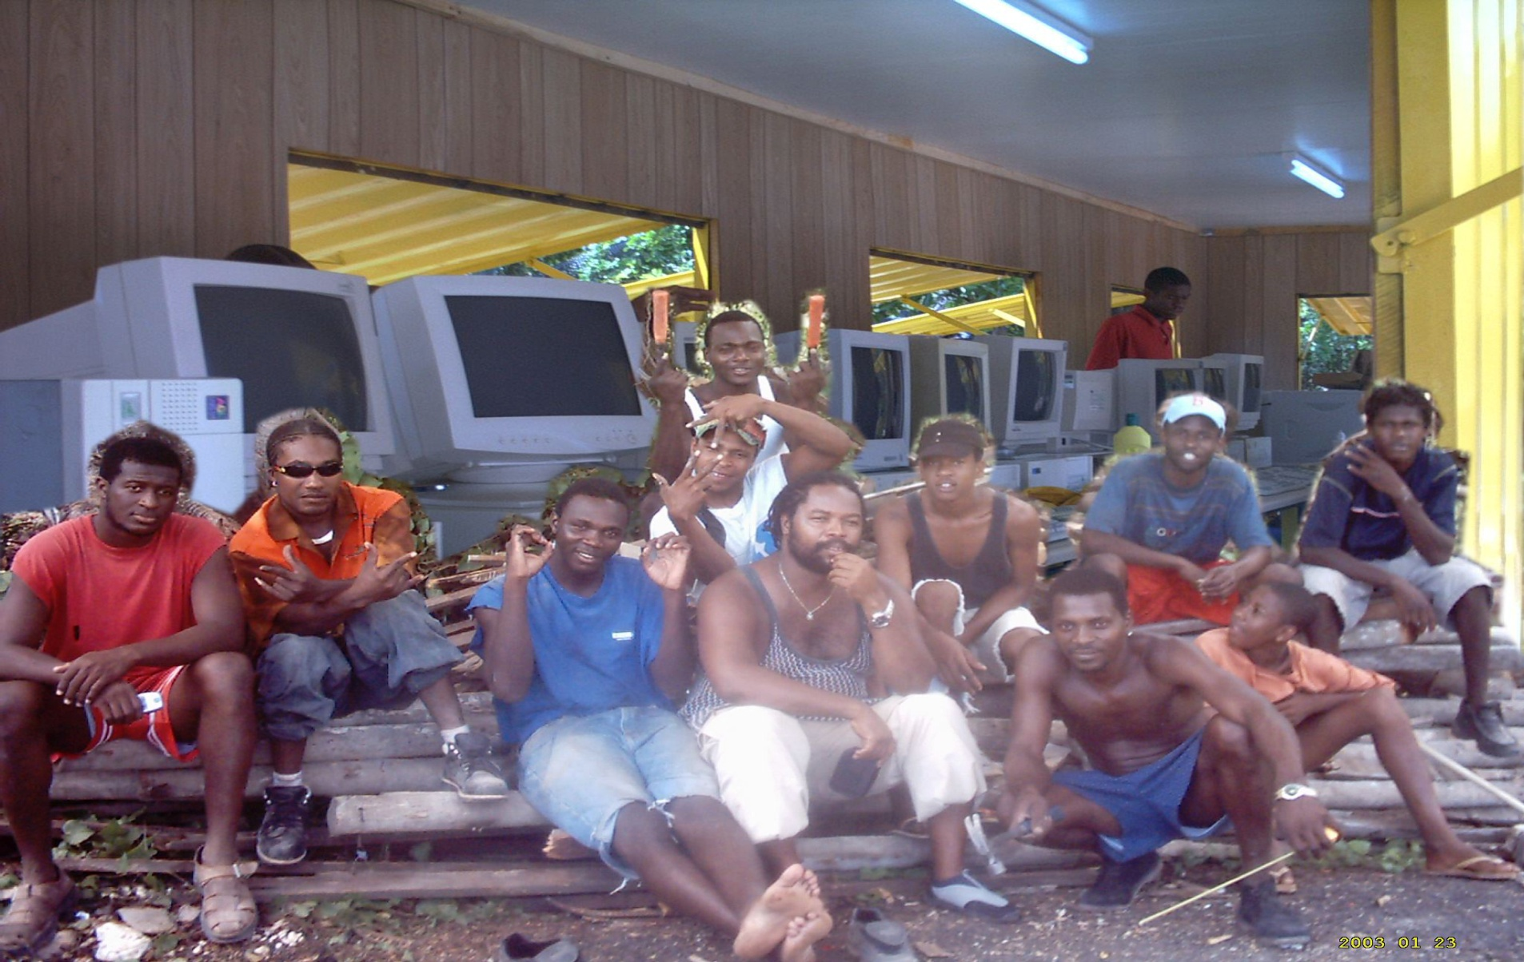

Slide 39
RECOMMENDATIONS
Upfront work has to be done to ensure community ownership, especially where initiatives are government sponsored
More training should be done on Development Entrepreneurship, forging and maintaining strategic alliances
Networking and mentorship are particularly important for fledgling telecenters

