Slide 1
Innovative Service Opportunities for Development; the Role for Telecentres in CARIFORUM……
Telecentres, bridges to agriculture and rural development in the CARIBBEAN
28th April, 2011
Santo Domingo, Rep. Dominicana
Telly Valerie Onu, CEC™, EMA e-Governance

Slide 2
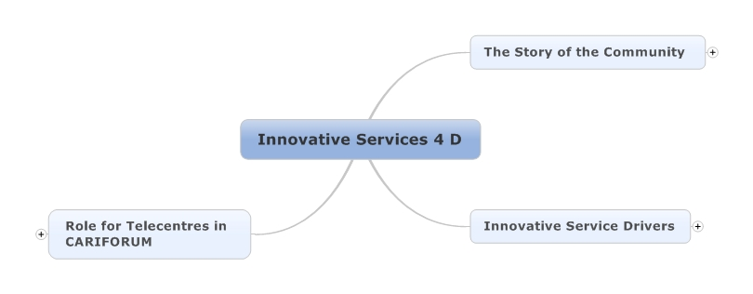
Content

Slide 3
THE COMMUNITY & IT’s NEEDS
Physical
Health
Social
Welfare
Government Services
Economic
Linked to Productive Sectors
Financial
Culture
Preserving Local Heritage
Support for traditional Practices – Group Lending
Human Capital
Training/ Education

Slide 4

GLOBAL DEVELOPMENT OBJECTIVES - MDGS
The Millennium Development Goals are seek to address the many of the development challenges

Slide 5
TYPES OF NEW INNOVATIVE SERVICE MODELS
Cooperative Services
Linkages/Connections
Entrepreneurial Support
Infomediary
Intermediary
Institutional Support
Capacity Building
E-Services – Government Services

Slide 6




INNOVATION SERVICE DRIVERS
BOTTOM OF THE PYRAMID
SOCIAL RESPONSIBILITY
TECHNOLOGY

Slide 7
FINANCIAL ASSETS
Service Model
Type of Service
Revenue Potential
Cooperative/Linkages
Group Lending (Susu/ Partner Hand/Osusu)
Commissions

Slide 8
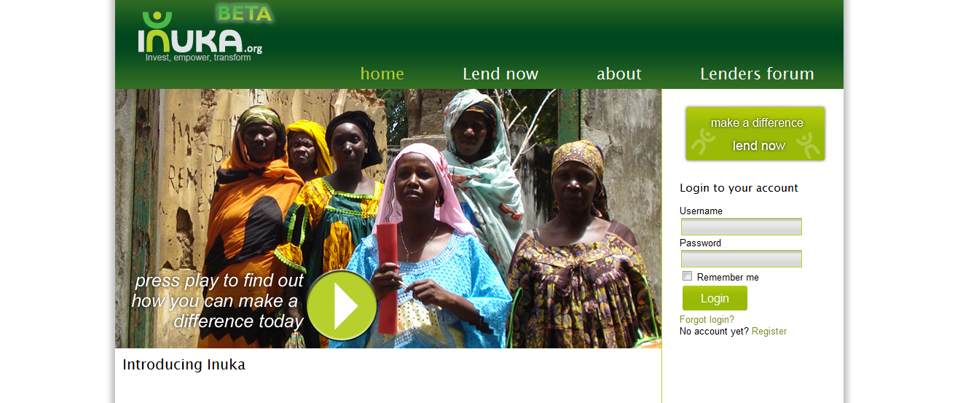
INUKA
Example: http://inuka.org

Slide 9
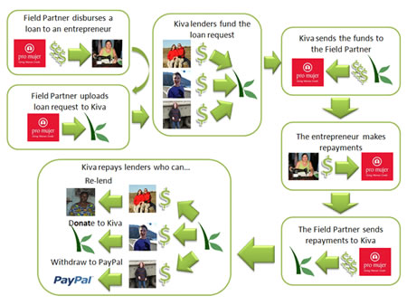
KIVA
Example: http://www.kiva.org

Slide 10
SOCIAL ASSETS
Service Model
Type of Service
Revenue Potential
Cooperative/e-services
Government Services : e-services –e.g Social Safety Net Programs/e-tax/Birth Docs
Services/Commissions

Slide 11

Bhoomi – Land Record Computerisation

Slide 12
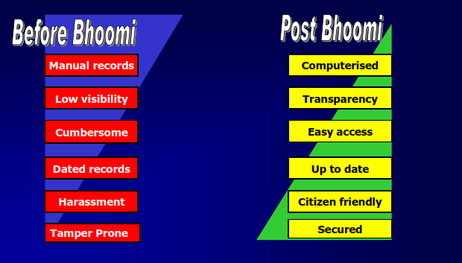

Slide 13
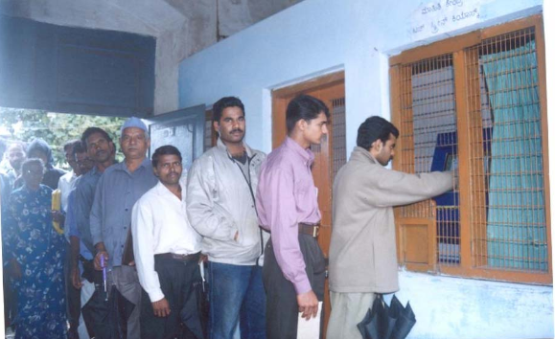

Slide 14
HUMAN CAPITAL ASSETS
Service Model
Type of Service
Innovation/Technology Tools
Revenue Potential
Cooperative/Mixed
ICT in Education/E-Learning
Open Course Ware
Content Authoring Tools
Open Source Content Platforms
Course Enrollment

Slide 15

Agri-Environment Programme – E-Learning
http://www.intelitek.com

Slide 16
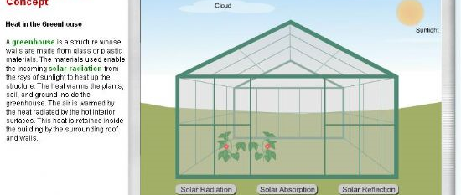
E-Learning Programmes – Locally Relevant Content

Slide 17
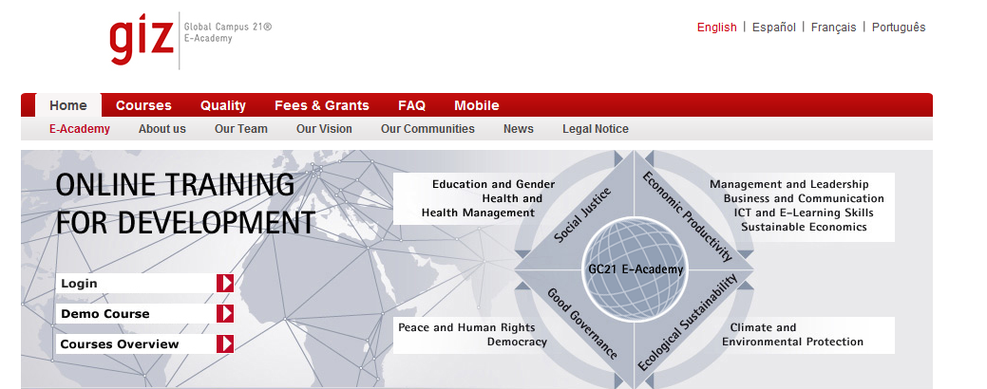
GIZ E-Academy – Opportunities for E-Learning
http://www.gc21-eacademy.org/

Slide 18
E-Learning Development and Implementation (ElDI)
Module 1: Instructional Design (ID)
· What is instructional design? Why is it important?
· How to analyse the learners characteristics?
· How to set the SMART learning objectives?
· What are different characteristics of eLearning?
· What eLearning scenario is well suited to my course?
Module 2: Content Development (CD)
· How to identify and create learning resources?
· How to add value to the course?
· How to prepare content for eLearning?
· What is storyboard? How to develop it?
Module 3: Interactivity (INT)
· What interactions could be integrated in elearning?
· How to use the different interaction tools?
· What is feedback?
Module 4: eLearning Technology (eLT)
· What are the functions of elearning technology?
· What are the technology standards?
· What is the open source software for elearning?
Module 5: eLearning Management (eLM)
· How to balance time, cost and quality of elearning?
· How to plan and implement elearning projects?
· How to assess elearning projects?
Module 6: Tutoring for eLearning Communities (TEL):
· What are virtual communities?
· What are the roles and skills of the e-tutors?
· How tutors to use communication tools effectively?
· What to do in this case if you were an e-tutor?

Slide 19
PHYSICAL CAPITAL ASSETS – Example.. Health
Service Model
Type of Service
Technology Tools
Decision Making Support
Data Collection
E.g. Episurveyor

Slide 20
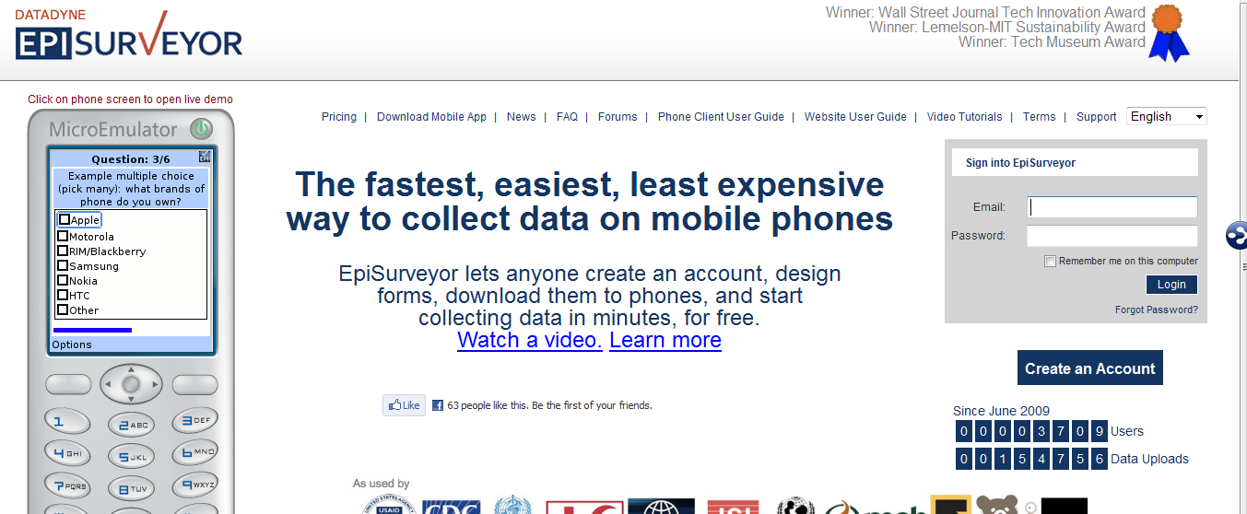
Episurveyor-M-Health

Slide 21
PHYSICAL CAPITAL ASSETS – Example.. Health
Service Model
Type of Service
Technology Tools
Linkages/Patient-Doctor
Telemedicine
Simple Tools-Skype Consultations, Appointment Setting

Slide 22
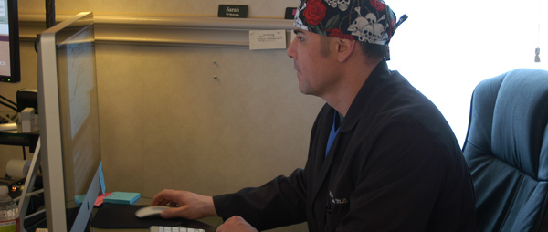
Patient Doctor Consultations
Skype Consultation:

Slide 23
ECONOMIC/NATURE ASSETS
Service Model
Type of Service
Technology Tools
Revenue Potential
Linkages
Heritage Tourism Intermediary
Internet Booking Engines
Subscriptions

Slide 24
ROLE OF TELECENTRES
Facilitating Information Interchange
Capacity and Capability Enhancement and Empowerment – Society Building
Fostering Innovation
Promote Sustainability (social, environment, economic)
Fostering Connections-Local Networks

Slide 25
Need for a Paradigm Shift/Open Mind/Sand Box
Definition of Community Needs
Community Target Segment
Community Partnerships: Co-Creation of Ideas to Solve Problems
Local Content
Local Knowledge
Buy In
Channel - Hubs and Spokes Model
Value Creation
PATHWAYS TO IMPLEMENTING INNOVATIVE SERVICE MODELS
Service Offering
Policies & Process
Innovation
Technology
Ensuring Key Resources & Capabilities are available or made available
WAY FORWARD FOR TELECENTRES
Defining Key activities
Identify and map Costs vs Revenue/Benefits
Identifying Key Partners

