Slide 1
ICT Access in Rural Areas in Jamaica
CTA Caribbean Telecentres Conference
Dominican Republic | April 28, 2011
Ayanna Samuels - ICT4D Consultant | Technology Policy Specialist, ICT4D Jamaica

Slide 2
ICT Access in Rural Areas in Jamaica
Situation
Public Policies
Issues and Perspectives

Slide 3
ICT Access in Rural Areas in Jamaica
SITUATION
Jamaica’s ICT indicators and Broadband Survey 2011
Funding support by IDRC
Fieldwork conducted by STATIN btwn Nov ‘10 & Jan ’11
Representative sample of 2200, response rate of 80%
Multi country and stakeholder involvement
  TPM, MSB, UWI Mona, UWI St. Augustine
  Observatory on the Info. Society in LAC (OSILAC)
  Economic Commission on LAC (ECLAC)
  Caribbean Telecommunications Union

Slide 4
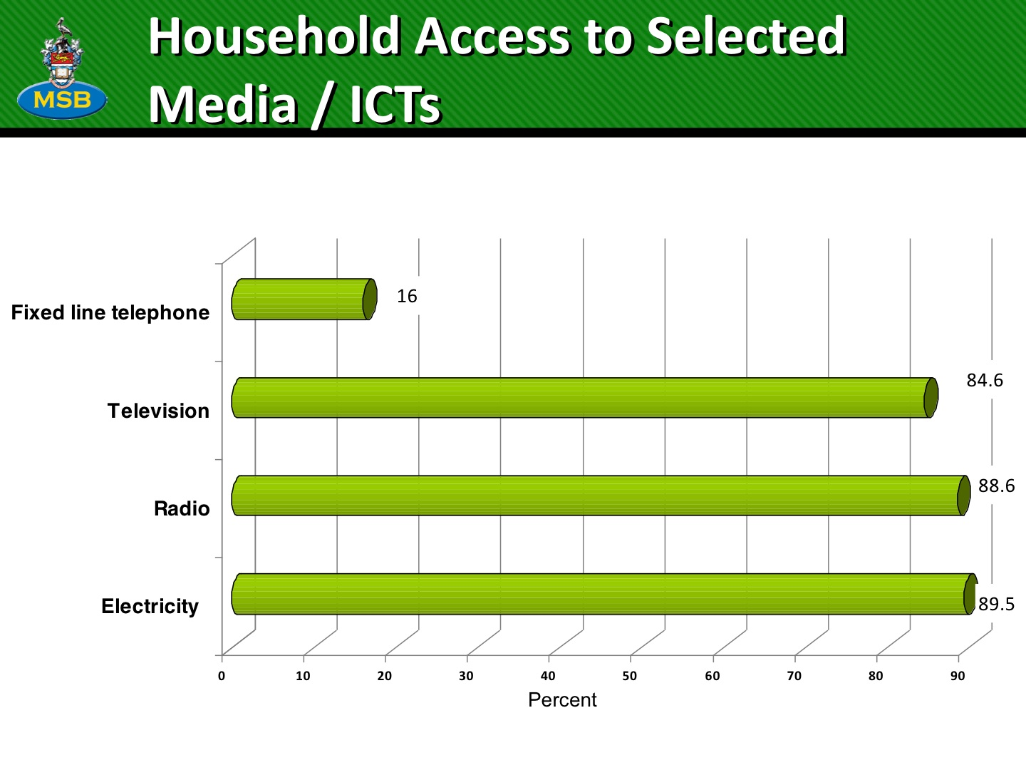

Slide 5
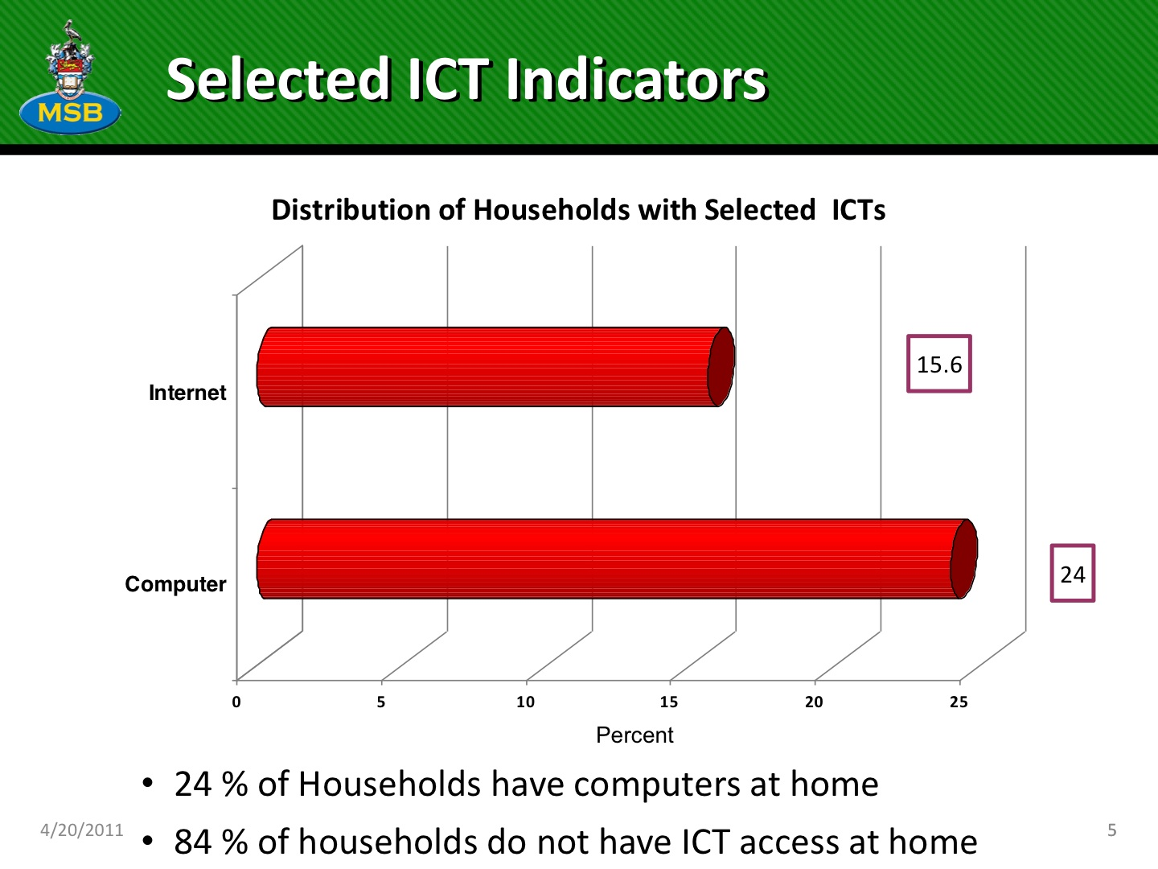

Slide 6
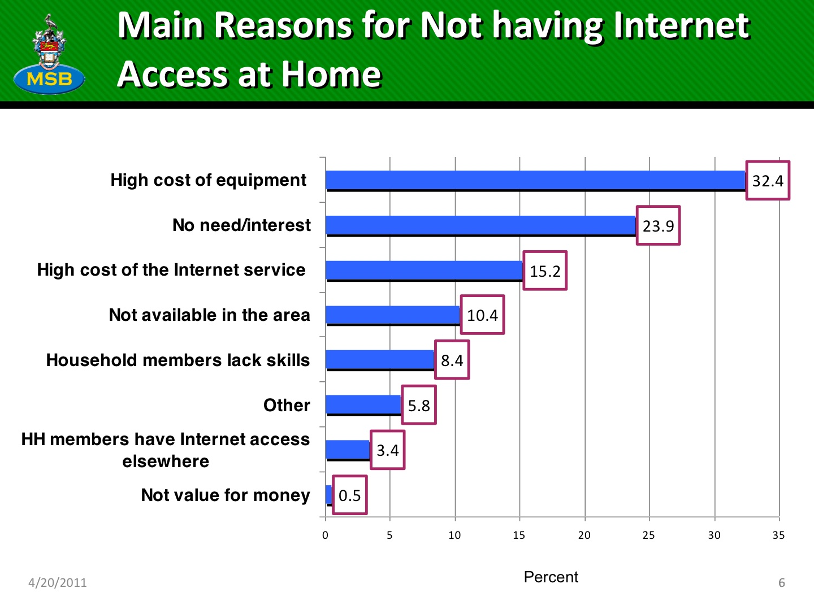

Slide 7
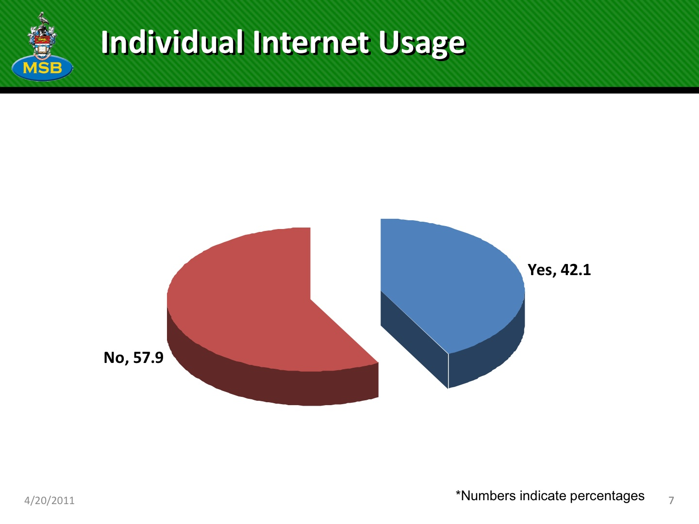
41% of individual Internet users hail from rural Jamaica

Slide 8
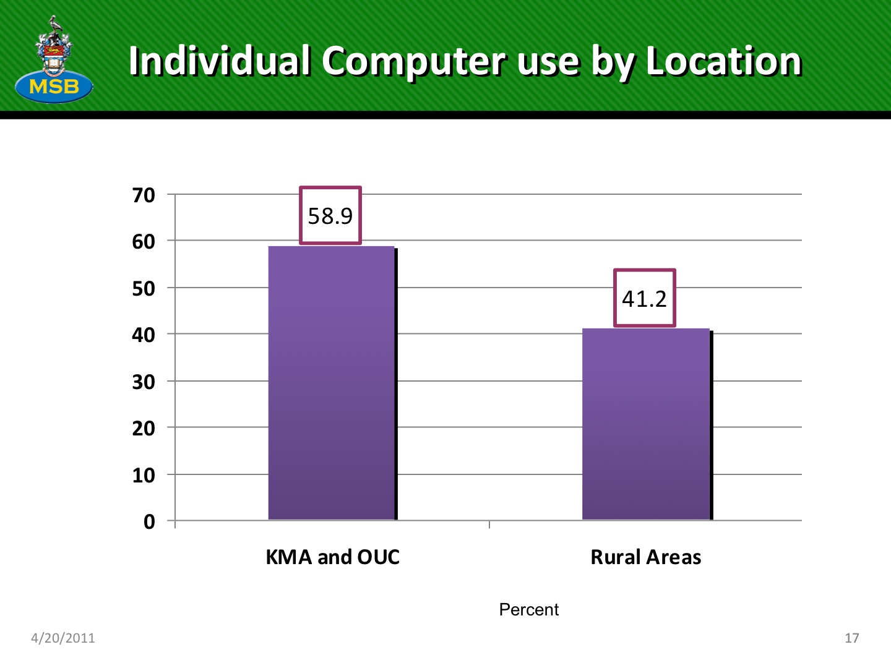

Slide 9
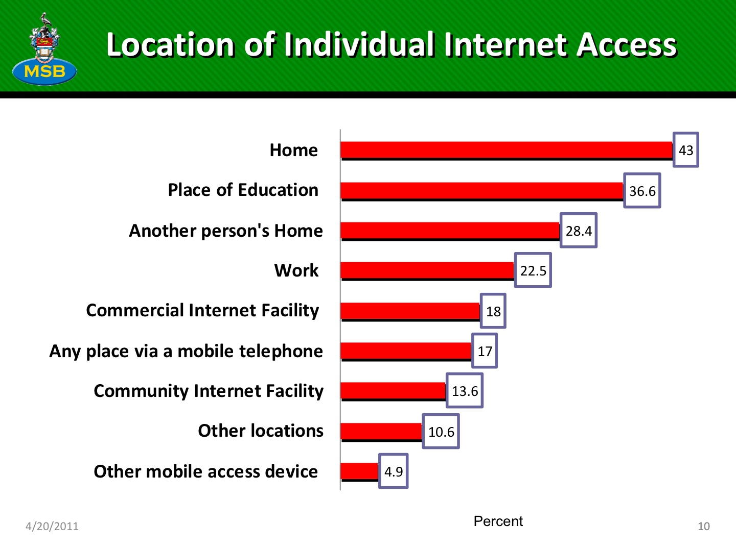

Slide 10
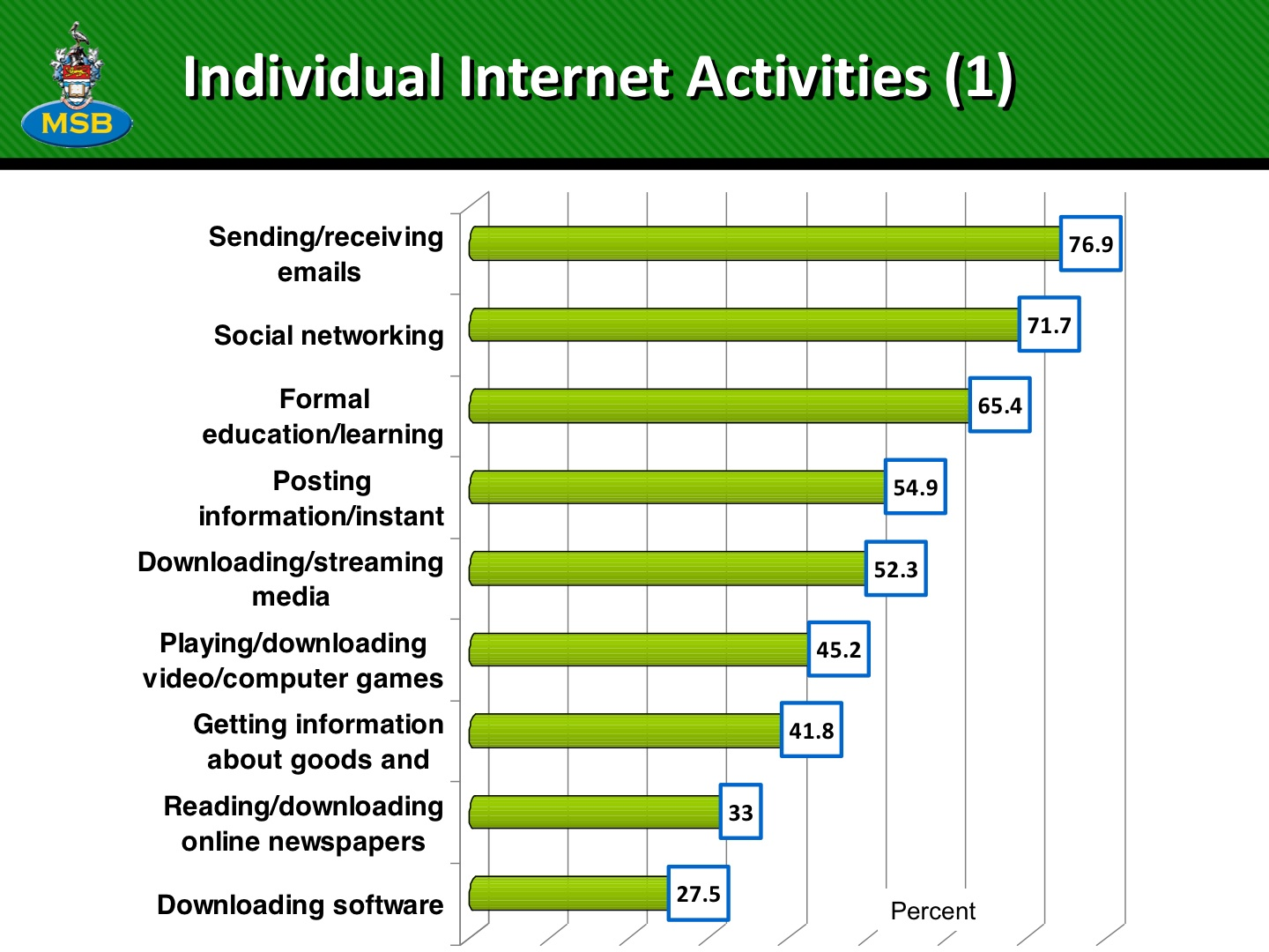

Slide 11
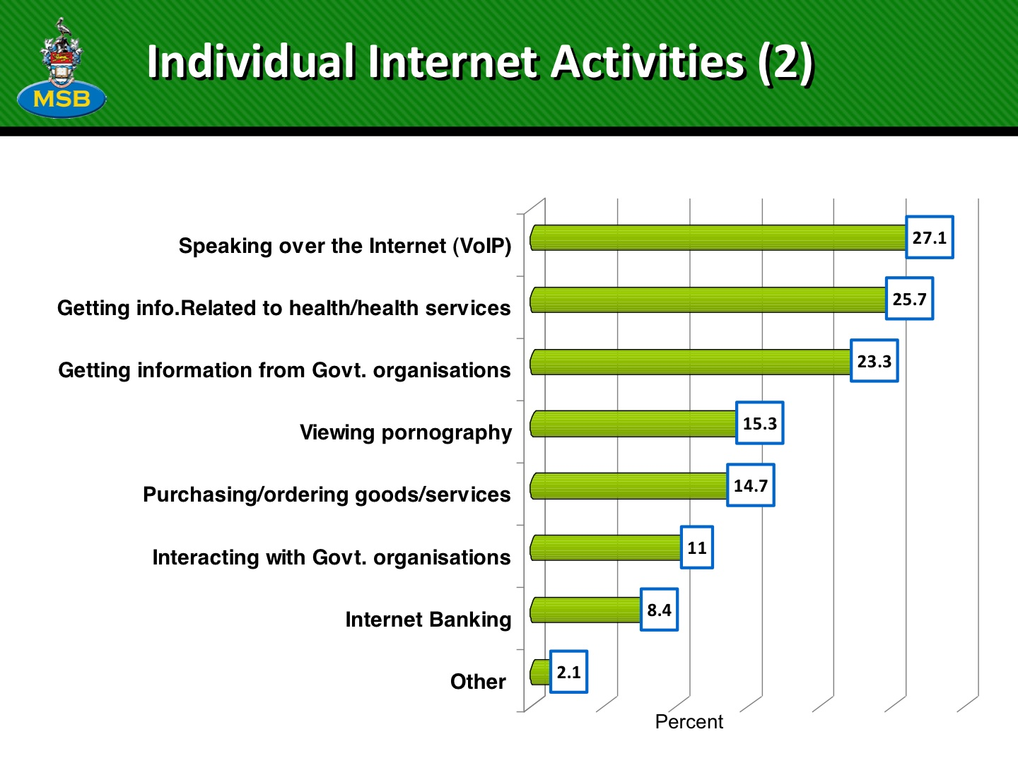

Slide 12
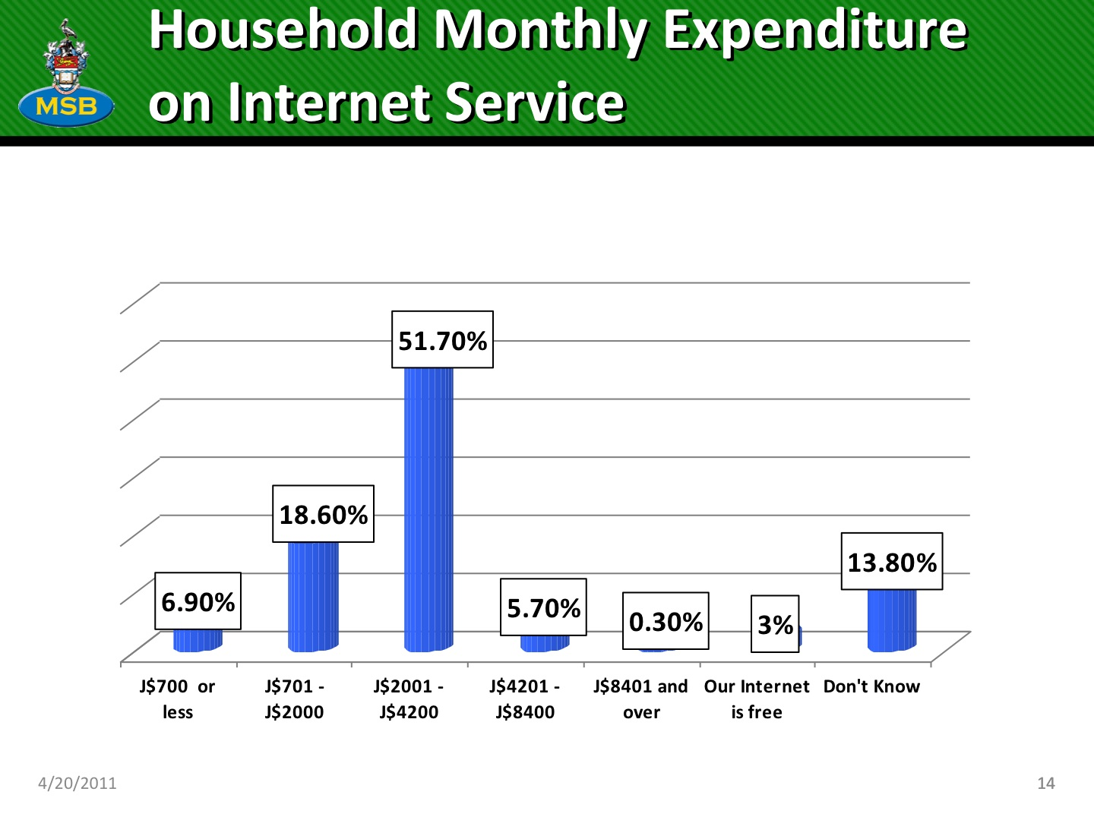

Slide 13
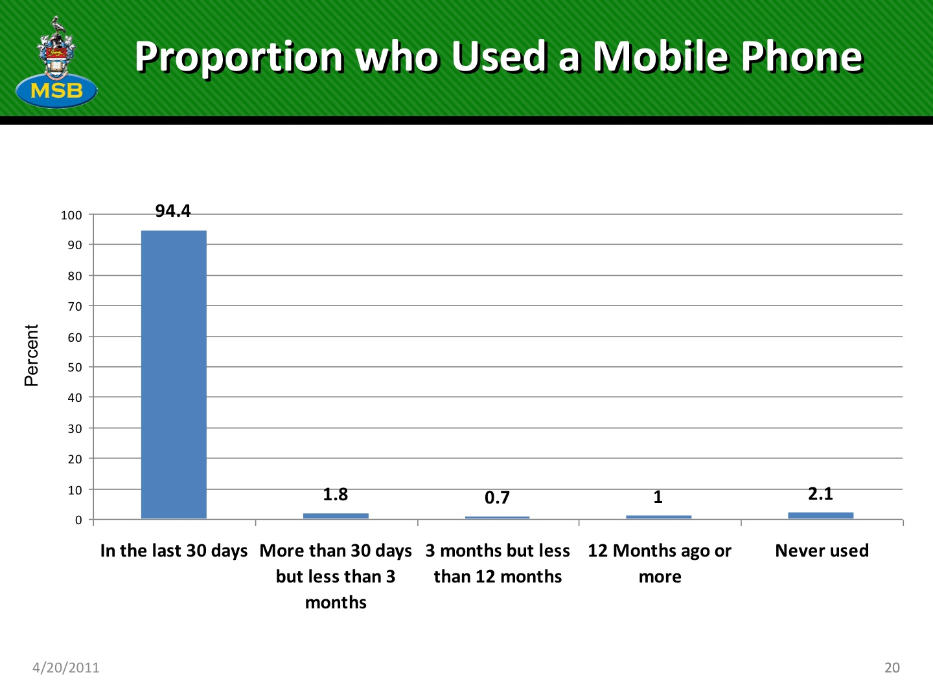

Slide 14
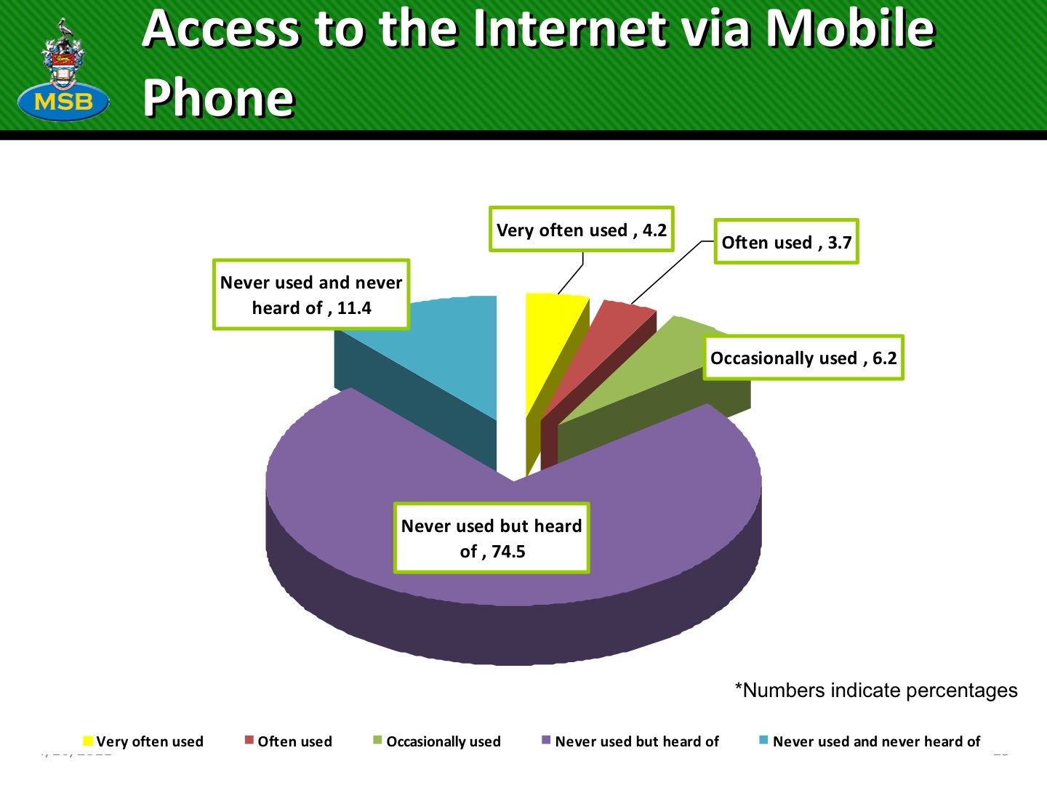

Slide 15
ICT Access in Rural Areas in Jamaica
SITUATION
IDB loan and constraints imposed by most recent IMF loan
has led to establishment of: 15 telecentres as at Apr 2011
the Office of the Prime Minister is administering this project
Up to 60 telecentres were planned
constraints of IMF loan meant education, training and community learning centres suffered
Focus turned to income earning sectors (income earned from customs, taxes etc).
Notes:
Since 2007 election of new administraton

Slide 16
ICT Access in Rural Areas in Jamaica
SITUATION
Universal Access Fund
led to establishment of: 42 telecentres as at Apr 2011
Telecentres set up in 13 of Ja’s 14 parishes
Trelawny is parish not yet outfitted
Of 42 telecentres 24 are located in rural Ja incl. Accompong, St. Elizabeth
14 telecentres currently being built, 11 in rural Ja incl 2 for Trelawny
102 telecentre applications now being processed, 74 are in rural Ja
Internet connectivity costs funded by the UAF for the first 2 years

Slide 17
ICT Access in Rural Areas in Jamaica
SITUATION
Universal Access Fund
RFP issued 4 years ago
> 6.5 M USD million project awarded in Apr 2011
Schools, post offices and libraries islandwide
Community Learning Centres (CLCs) will not be outfitted initially
CLCs along with residents of rural communities will be able to be outfitted once fibre is laid islandwide
Set up of UAF set to change due to usage concerns from US authorities
Notes:
Since 2007 election of new administraton

Slide 18
ICT Access in Rural Areas in Jamaica
SITUATION
Enhancement of Agricultural industry
ICT infrastructure underpins the knowledge economy
Ja’s Rural Agricultural Development Association (RADA)
RADA’s Agricultural Policy includes ICTs
database with agricultural information going back 25 years
Slash Roots technical professionals community
developers will create applications of utility to farmers
  smart phones will not be required.
completion date for data set completion set for end of May 2011.
Notes:
RADA’S

Slide 19
ICT Access in Rural Areas in Jamaica
SITUATION
Enhancement of Agricultural industry
Telecentres such as Jeffrey Town in St. Mary are accessing RADA’s online produce price page via the Internet
Using radio to share prices with neighbourhood farmers
  Medium is Jeffrey Town community radio station
Some telecentres in regional agricultural networks such as those supported by CTA
  Caribbean Coastal Area Mgmt Fdtn (Rural Westmoreland)
  Bluefields (semi-urban Clarendon)
  contribute to the discussions on fisheries.

Slide 20
ICT Access in Rural Areas in Jamaica
SITUATION
Enhancement of Agricultural industry
For more information on this type of networking by telecentres and access see:
Kirton, C. and Bailey, A. (2003) Establishment and Development of a Regional Agricultural Network in the Caribean, CTA/IICA.
Chesney, A., Bailey, A., Duncan, K. and Francis, D. (2004) Sharing Good Practice: Network Experiences - The CaRAPN contribution, CTA.
Bailey, A. and Ngwenyama, O. (2011) The challenge of e-participation in the digital city: Exploring generational influences among community telecentre users, Telematics and Informatics, 28, 3, 204 - 214.
Notes:
Since 2007 election of new administraton

Slide 21
ICT Access in Rural Areas in Jamaica
PUBLIC POLICIES
Caribbean ICT indicators and Broadband Survey
Shift in consumer appetite from voice and toward broadband value added services is required.
Long term interventions needed in training to ensure that ICT uptake translates into economic growth.
Move to implement the policy and regulatory framework for increasing broadband rollout
Also for increasing competition.
– New converged ICT Business models – Government to lead by example
– Infrastructure sharing
– Facilitating growth of content and application providers
The need for better integration of ICT into development strategic planning for all sectors, education, banking, commerce, health etc

Slide 22
ICT Access in Rural Areas in Jamaica
PUBLIC POLICIES
Govt intervention necessary to promote provision of free broadband in:
  community learning centres
  other community based educational institutions
  ICT4D Ja produced a policy paper to this effect in early 2010
    Lobbying effort has been difficult

Slide 23
ICT Access in Rural Areas in Jamaica
ISSUES AND PERSPECTIVES
Connectivity Costs
Hardware maintenance and costs
Inferiority Complex leading to low turn outs
Gender crisis
Illiteracy and innumeracy ranking high in rural areas
Caribbean ICT indicators and Broadband survey implications
Telecentre staff have to adapt to the needs of their users and provide other training and support.

Slide 24
ICT Access in Rural Areas in Jamaica
ISSUES AND PERSPECTIVES
Caribbean regional ICT development strategy (2010- 2015)
absence of verifiable indicators of success
general disconnect between a country’s development policy and its ICT strategy
difficult to properly measure gains at a regional level
Regional Goals to be Achieved by 2015
50% of Member States raised to top 20% of countries on global networked readiness and digital development indices;
With others increasing in present rank
Jamaica 78th position Trinidad

Slide 25
ICT Access in Rural Areas in Jamaica
SOLUTIONS/CONCLUSIONS
Telecentres have to take information to the people, become community “champions” (Bailey, A.)
Develop a systematic understanding of the potential and limitations of telecentres as a mechanism for social and economic development (Bailey, A.)
Increase economic capability of telecentres
  Telecentre competition
  UAF Jamaica islandwide broadband rollout project
Stakeholders must seek to lobby their respective govts to introduce policy which promotes growth and reduction of expenses faced by telecentres
Get information directly from farmers and community members in order to increase utility of telecentre offerings

Slide 26
ICT Access in Rural Areas in Jamaica
SOLUTIONS/CONCLUSIONS
Cost of equipment and connectivity still most critical barrier to increased levels of Internet and computer penetration
Public education campaign sorely needed so general populace understands the value of Internet access
Further research needed to capitalize on potential of applications using mobile connectivity

Slide 27
ICT Access in Rural Areas in Jamaica
THANK YOU
Ayanna.Samuels@gmail.com
1.876.383.1204 (mobile)
Skype username: terehas

